Slide 1

Knowledge Neurons in Pretrained Transformers
Damai Dai, Li Dong, Yaru Hao, Zhifang Sui, Baobao Chang, Furu Wei
1. MOE Key Lab of Computational Linguistics, Peking University,
2. Microsoft Research

Slide 2
Introduce the concept of knowledge neurons and propose a knowledge attribution method to identify the knowledge neurons that express specific factual knowledge in the fill in-the-blank cloze task.
Conduct both qualitative and quantitative analysis to show that knowledge neurons are positively correlated to knowledge expression.
Present preliminary studies of leveraging knowledge neurons to edit factual knowledge.

Slide 3
Related Work
Probing Knowledge in Pretrained Models
To retrieve knowledge in pretrained models (such as BERT) using cloze queries.
Mining-based and paraphrasing-based methods.
Closedbook question answering to measure how much knowledge a pretrained model has stored in its parameters.
Measure and improve the consistency of pretrained models with respect to factual knowledge prediction.
Attribution Methods
Aim to attribute the model output to input features using different measures
Integrated gradient method

Slide 4
Introduction
Present preliminary studies on how factual knowledge is stored in pretrained Transformers by introducing the concept of knowledge neurons.
Examine the fill-in-the-blank cloze task for BERT.
Propose a knowledge attribution method, based on integrated gradients, to identify knowledge neurons.
Have investigated that the activation of such knowledge neurons is positively correlated to the expression of their corresponding facts.
Attempt to leverage knowledge neurons to edit (such as update, and erase) specific factual knowledge without fine-tuning.
Results shed light on understanding the storage of knowledge within pretrained Transformers.

Slide 5
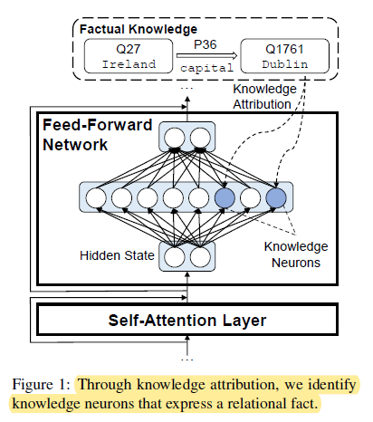
View feed-forward network (i.e., two-layer perceptron) modules in Transformer as key-value memories.
The hidden state is fed into the first linear layer and activates knowledge neurons; then, the second linear layer integrates the corresponding memory vectors.
Analysis shows that- activation of the identified knowledge neurons is positively correlated to the knowledge expression (3 ways)

Slide 6

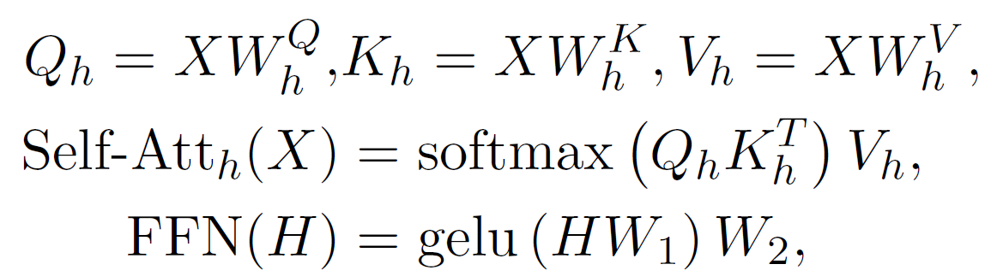
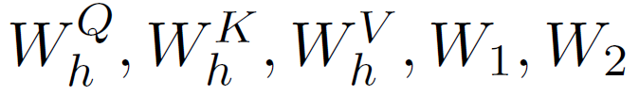

Transformer Block
Self-Attention Layer
Feed Forward Layer
Input matrix :
Parameter matrices:
Hidden state:
Connections Between Self-Attention and FFN
Self-Att(.) similar to FFN(.)
query-key-value vs query vector(input to FFN), keys & values(two linear layers of FFN)

Slide 7
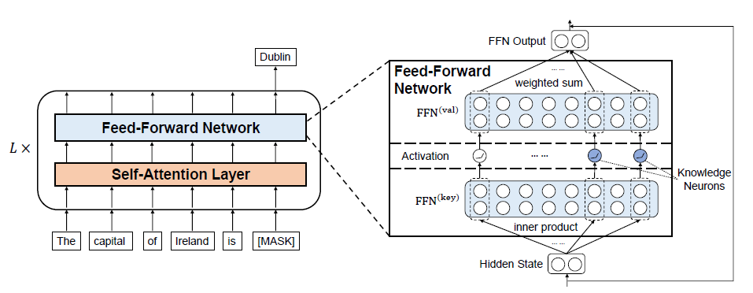
Figure 2: Illustration of how an FFN module in a Transformer block works as a key-value memory
Hypothesize that factual knowledge is stored in FFN memories and expressed by knowledge neurons.

Slide 8
Example – Knowledge Accessing Task
Fact : <Ireland, capital, Dublin>
Triplet <h,r,t>
h - head entity, t – tail entity, r – relation between head & tail
Possible query : “The capital of Ireland is _____”
(knowledge-expressing prompt)

Slide 9
Knowledge Attribution
Propose a knowledge attribution method based on integrated gradients.
Can evaluate the contribution of each neuron to knowledge predictions.
Complete process to identify knowledge neurons:
(1) produce n diverse prompts
(2) for each prompt, calculate the knowledge attribution scores of neurons;
(3) for each prompt, retain the neurons with attribution scores greater than the attribution threshold t, obtaining the coarse set of knowledge neurons;
(4) considering all the coarse sets together, retain the knowledge neurons shared by more than prompts p%

Slide 10
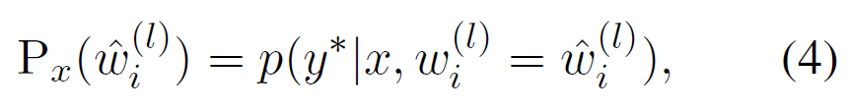


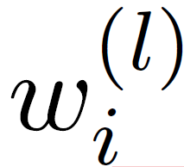
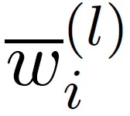
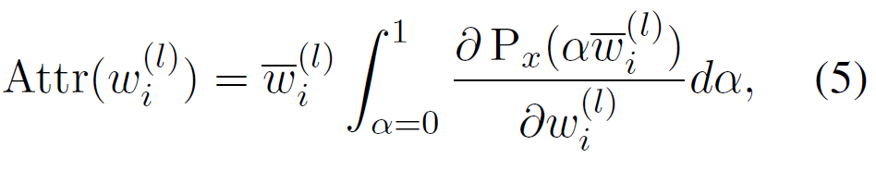
Process of Knowledge Attribution
1) Given an input prompt x, Calculate probability of the correct answer predicted by a pretrained model
y* - correct answer
- i-th intermediate neuron in the l-th FFN
- a constant
2) Calculate the attribution score
Change from 0 to its original value calculated by the pretrained model
Integrate the gradients
If the neuron has a great influence on the expression of a fact, the gradient will be salient, which in turn has large integration values.
problem
Calculates gradient of the model output wrt

Slide 11
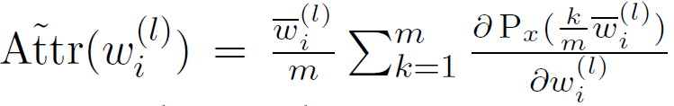
Riemann approximation
m = 20 , number of approximation steps
With the attribution algorithm, can identify a coarse set of knowledge neurons whose attribution scores are greater than a threshold t.

Slide 12
Knowledge Neuron Refining
To identify knowledge neurons more accurately.
Filter out “false-positive” neurons.
For different prompts corresponding to the same fact, hypothesize that they share the same set of “true-positive” knowledge neurons, do not share the “false positive” knowledge neurons.
So, can refine the coarse set of knowledge neurons by retaining only neurons that are widely shared among these prompts.

Slide 13
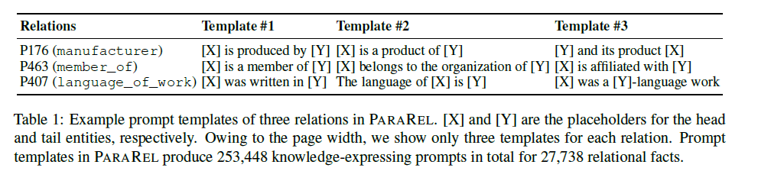
Experiments
Experimental Settings
BERT-base-cased
For each prompt, set the attribution threshold t to 0.2 times the maximum attribution score. For each relation, initialize the refining threshold p% as 0.7. Then, increase or decrease it by 0.05 at a time until the average number of knowledge neurons lies in [2, 5].
Dataset
Fill in-the-blank cloze task based on the PARAREL dataset
For each relational fact, fill in the head entity in
prompt templates and leave the
tail entity as a blank to predict.
To guarantee the template diversity,
filter out relations with fewer than
4 prompt templates and finally keep
34 relations, where each relation has
8.63 different prompt templates on average.

Slide 14
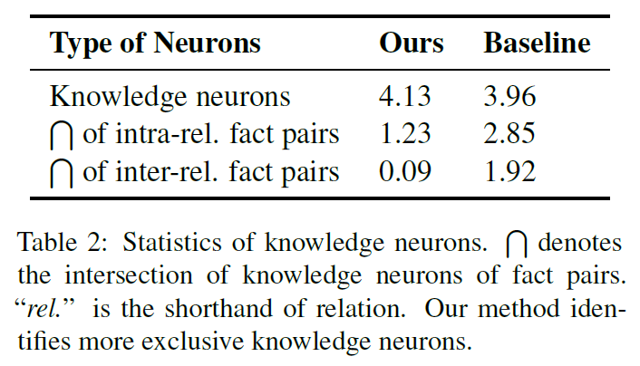
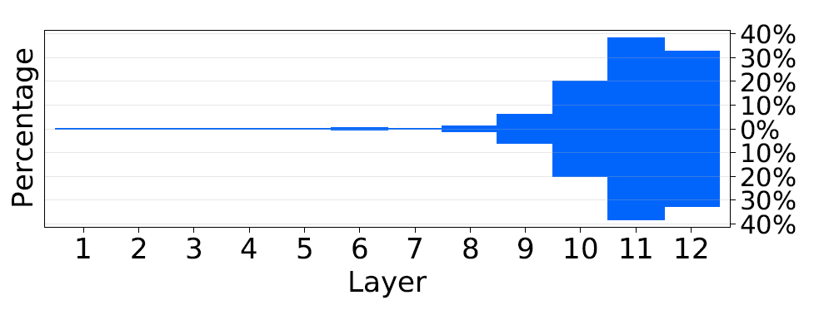
Statistics of Knowledge Neurons
Knowledge neuron intersection of different relational facts
Layer distribution

Slide 15
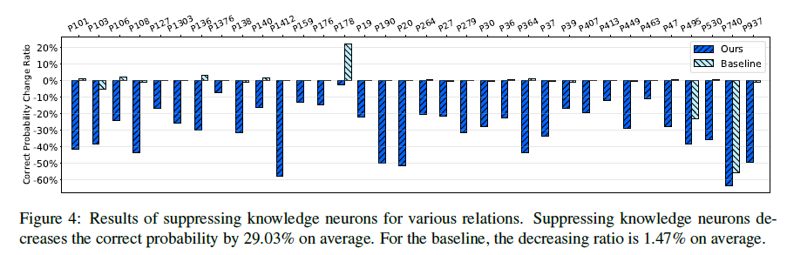
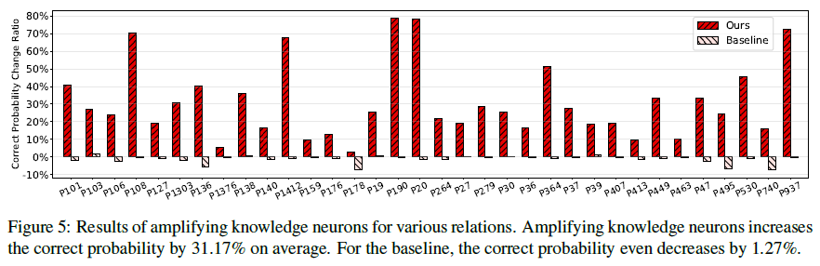
Knowledge Neurons Affect Knowledge Expression
Investigate how much knowledge neurons can affect knowledge expression.
1) Suppressing knowledge neurons by setting their activations to 0
(2) Amplifying knowledge neurons by doubling their activations
P178(developer)

Slide 16
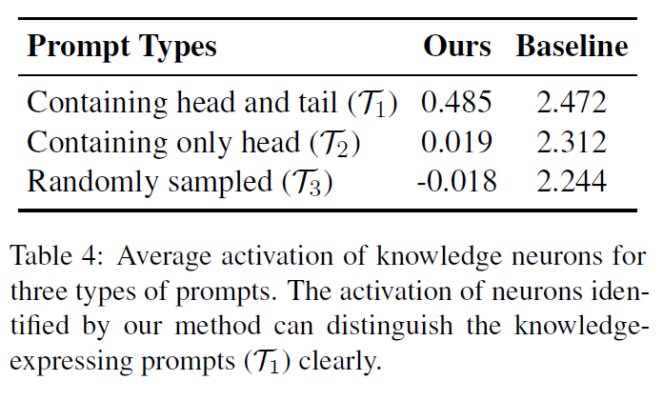
Knowledge Neurons are Activated by Knowledge-Expressing Prompts
BINGREL Dataset

Slide 17
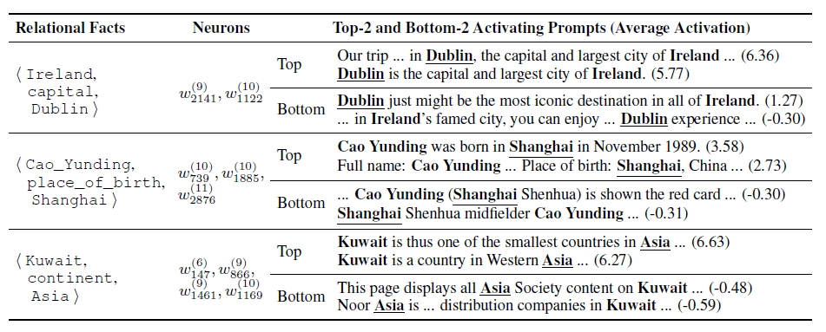
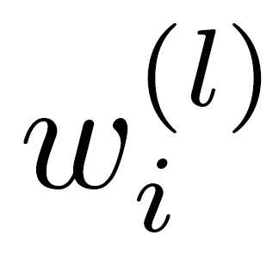
Table 3: Example relational facts along with their knowledge neurons, their top-2 and bottom-2 activating prompts, and the corresponding neuron activation.
denotes the i-th intermediate neuron at the l-th FFN

Slide 18
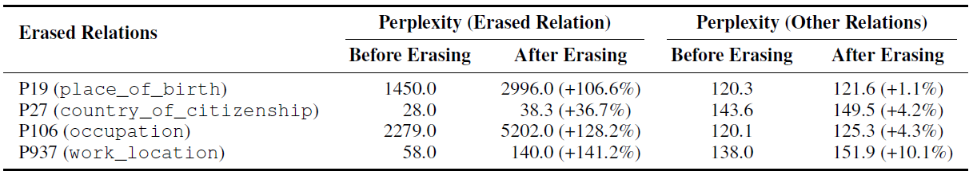
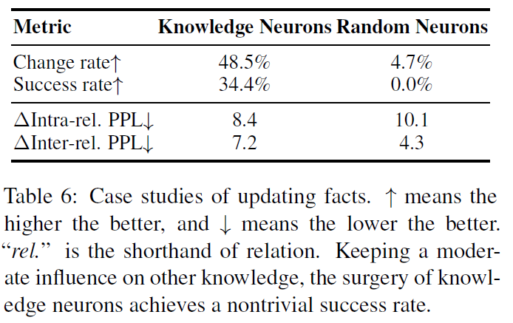
Case Studies
Erasing facts
Updating relations

Slide 19
Conclusion
Propose an attribution method to identify knowledge neurons.
Discovered that suppressing or amplifying the activation of knowledge neurons can accordingly affect the strength of knowledge expression.
Quantitative and qualitative analysis on open-domain texts shows that knowledge neurons tend to be activated by the corresponding knowledge-expressing prompts.
Present two preliminary case studies that attempt to utilize knowledge neurons to update or erase knowledge in pretrained Transformers.

Slide 20
Limitations
They have examined knowledge neurons based on the fill-in-the-blank cloze task, while knowledge can be expressed in a more implicit way.
It is an open question whether Transformer can utilize stored knowledge in a generalized way, such as for reasoning.
The interactions between knowledge neurons also remain under explored.
Focus on factual knowledge for ease of evaluation, even though their method is also applicable for other types of knowledge.
Use the single-word blank in cloze queries for simplicity, which requires multi-word extensions.

Slide 21
Future Direction
To figure out how knowledge neurons work in multilingual pre trained transformers.
Notes:
Similar paper:
Analyzing Individual Neurons in Pre-trained Language Models
https://arxiv.org/pdf/2010.02695.pdf –attribution methods used
Transformer Feed-Forward Layers Are Key-Value Memories
https://arxiv.org/pdf/2012.14913.pdf
Kformer: Knowledge Injection in Transformer Feed-Forward Layers
https://arxiv.org/pdf/2201.05742.pdf
GitHub resources:
https://github.com/Hunter-DDM/knowledge-neurons
https://github.com/EleutherAI/knowledge-neurons

